Slide 1
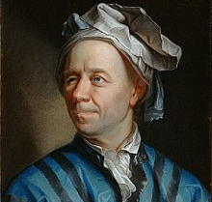

Slide 2

$$e^{iθ}=\cos\left(θ\right)+i\sin{(θ)}$$

Slide 3



$$e^{iθ}=\cos\left(θ\right)+i\sin{(θ)}$$
$$↓$$
$$e^{iπ}+1=0$$

Slide 4

The Seven Bridges of Konigsberg, 1736
Leonhard Euler

Slide 5
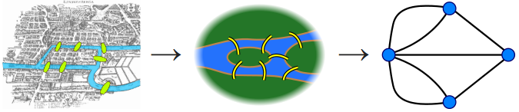
The Seven Bridges of Konigsberg, 1736
Leonhard Euler

Slide 6
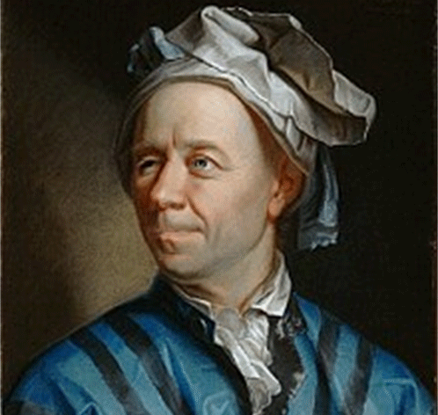
The Seven Bridges of Konigsberg
Leonhard Euler

Slide 7

Network analysis in R
An introduction to network analysis and visualization using igraph in R
Nate Pollesch and Jennifer Olker
Postdoctoral Researchers
United States Environmental Protection Agency
Mid-Continent Ecology Division - Duluth, MN USA

Slide 8
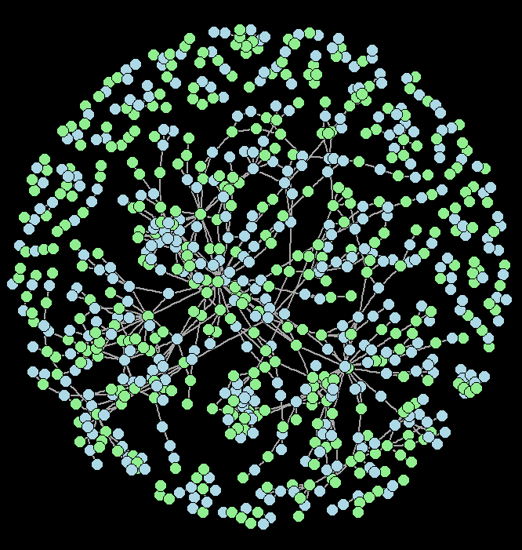
Outline for talk
Intro to networks
Creating and importing networks into R
Visualization of networks
Some sample network analyses
The AOPWiki Network (from Pollesch et al., 2019)
Package: igraph – default layout with modified node colors and size. Labels and arrows removed.

Slide 9
Intro to networks

Slide 10
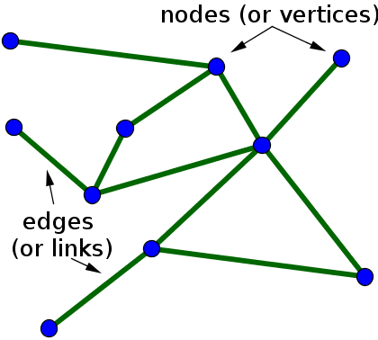
Networks are graphs and graphs are…
Intro to networks
…made of nodes (vertices) and edges
Node
Edge
Edge
Node
Edge
Node

Slide 11
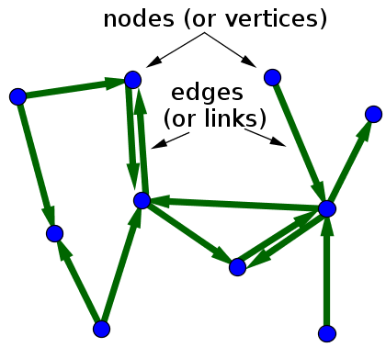
Networks are graphs and graphs are…
Intro to networks
…made of nodes (vertices) and edges
…specified as directed or undirected

Slide 12
Networks are graphs and graphs are…
Intro to networks
…made of nodes (vertices) and edges
…specified as directed or undirected

Slide 13
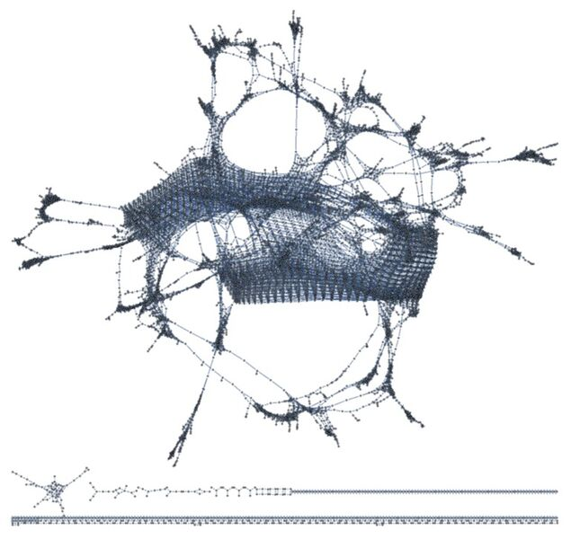
Networks are graphs and graphs are…
Intro to networks
…made of nodes (vertices) and edges
…specified as directed or undirected
…complex (and awesome looking)
Pore network graph from a fractal model of porous media. (unpublished). Made using Mathematica software.

Slide 14
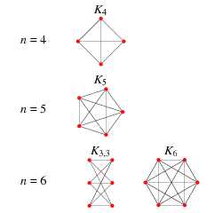
Networks are graphs and graphs are…
Intro to networks
…made of nodes (vertices) and edges
…specified as directed or undirected
…complex (and awesome looking)
…simple (and mathy)
Complete and bipartite graphs, (Wolfram Mathworld )

Slide 15
Networks are graphs and graphs are…
Intro to networks
…made of nodes (vertices) and edges
…specified as directed or undirected
…complex (and awesome looking)
…simple (and mathy)
…used for modeling LOTS of phenomena and systems. A sample of the variety includes social interactions, transportation systems, information flow, disease transmission, porous media, organizational structure, food webs, metabolic function, energy transmission, adverse outcome pathways, and the emotional brain

Slide 16
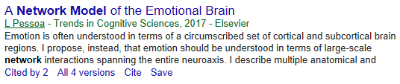
Networks are graphs and graphs are…
Intro to networks
…made of nodes (vertices) and edges
…specified as directed or undirected
…complex (and awesome looking)
…simple (and mathy)
…used for modeling LOTS of phenomena and systems. A sample of the variety includes social interactions, transportation systems, information flow, disease transmission, porous media, organizational structure, food webs, metabolic function, energy transmission, adverse outcome pathways, and the emotional brain

Slide 17
Networks are graphs and graphs are…
Intro to networks
…made of nodes (vertices) and edges
…specified as directed or undirected
…complex (and awesome looking)
…simple (and mathy)
…used for modeling LOTS of phenomena and systems. A sample of the variety includes social interactions, transportation systems, information flow, disease transmission, porous media, organizational structure, food webs, metabolic function, energy transmission, adverse outcome pathways, and the emotional brain
… not too bad to deal with in R!

Slide 18
Intro to networks
What do nodes and edges represent in your applications?
Any examples to share?

Slide 19
Creating and importing networks into R

Slide 20
Creating networks from scratch
Creating and importing networks into R
Edge list approach
Vertex from | Vertex to
V1 | V2
V2 | V1
V2 | V3
V3 | V1
Two column vectors
First column is a vector of “from” vertices
Second column is a vector of “to” vertices
Each row is than an edge between two vertices.
Matrix with dimension “no of edges x 2”

Slide 21
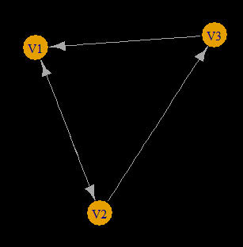
Creating networks from scratch
Creating and importing networks into R
Edge list approach
Vertex from | Vertex to
V1 | V2
V2 | V1
V2 | V3
V3 | V1
Two column vectors
First column is a vector of “from” vertices
Second column is a vector of “to” vertices
Each row is than an edge between two vertices.
Matrix with dimension “no of edges x 2”

Slide 22

Creating networks from scratch
Creating and importing networks into R
Adjacency Matrix approach
V1 V2 V3
V1
V2
V3
$\begin{matrix}0 & 1 & 0 \\ 1 & 0 & 1 \\ 1 & 0 & 0\end{matrix}$
Matrix of 0s and 1s
Entries read as rows. The 1 entry in row 1 means “edge from V1 to V2”
Square matrix with dimension
“number of vertices x number of vertices”

Slide 23
Creating networks from scratch
Creating and importing networks into R
Adjacency Matrix approach
V1 V2 V3
V1
V2
V3
$\begin{matrix}0 & 1 & 0 \\ 1 & 0 & 1 \\ 1 & 0 & 0\end{matrix}$
Matrix of 0s and 1s
Entries read as rows. The 1 entry in row 1 means “edge from V1 to V2”
Square matrix with dimension
“number of vertices x number of vertices”

Slide 24
Creating networks from scratch
Creating and importing networks into R
Edge list approach
Adjacency Matrix approach
Vertex from | Vertex to
V1 | V2
V2 | V1
V2 | V3
V3 | V1
V1 V2 V3
V1
V2
V3
$\begin{matrix}0 & 1 & 0 \\ 1 & 0 & 1 \\ 1 & 0 & 0\end{matrix}$
Two column vectors
First column is a vector of “from” vertices
Second column is a vector of “to” vertices
Each row is than an edge between two vertices.
Matrix with dimension “no of edges x 2”
Matrix of 0s and 1s
Entries read as rows. The 1 entry in row 1 means “edge from V1 to V2”
Square matrix with dimension
“number of vertices x number of vertices”

Slide 25
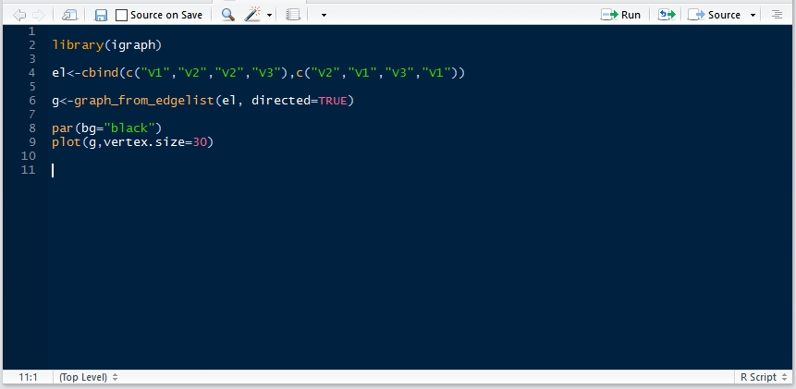
Creating and importing networks into R
Creating networks from scratch
Edge list approach
Vertex from | Vertex to
V1 | V2
V2 | V1
V2 | V3
V3 | V1
V1 V2 V3
V1
V2
V3
$\begin{matrix}0 & 1 & 0 \\ 1 & 0 & 1 \\ 1 & 0 & 0\end{matrix}$

Slide 26
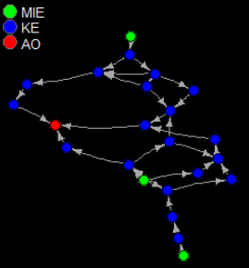
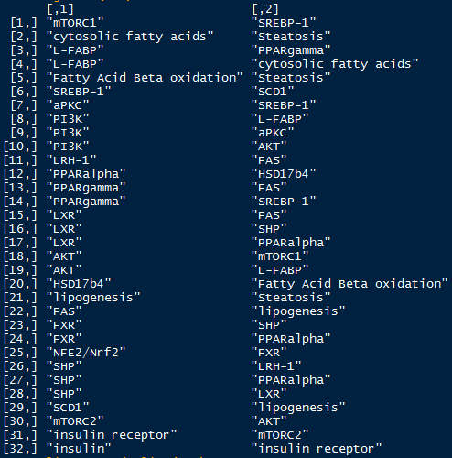
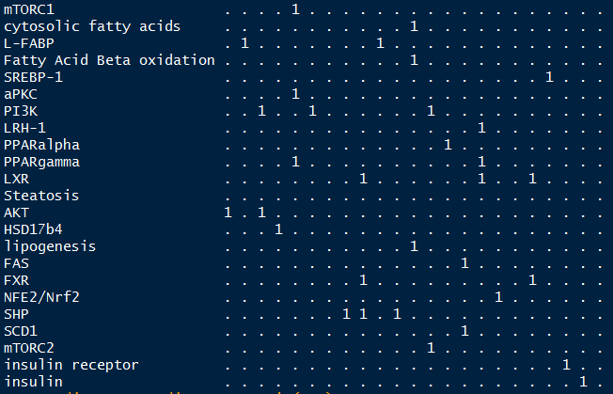
Creating and importing networks into R
Creating networks from scratch
Edge list approach
Adjacency Matrix approach

Slide 27
Attributes of nodes and edges

Slide 28
Structure of IGraph objects
Attributes of nodes and edges
IGraph object “g”
V(g)
E(g)
V(g)$attr2
E(g)$attr2
E(g)$attr1
V(g)$attr1
V(g)$...
E(g)$...
Vertex
graph
Edge

Slide 29
Some IGRAPH Object Attributes
Attributes of nodes and edges
Vertex Attributes – V(g)$...
Edge Attributes – E(g)$...
V(g)$name – List of vertex names
V(g)$size – Vertex size
V(g)$color – Vertex color
V(g)$label – Vertex label (for plotting)
V(g)$value – Any value you want to store for a given node!
E(g)$name – List of edge names
E(g)$weight – Edge weight
E(g)$color – Edge color
E(g)$label – Edge label (for plotting)
E(g)$value – Any value you want to store for a given node!
Notes:
Assigning and accessing vertex and edge attributes is critical to conduct analyses on the graph objects. More on attributes later, hint: vector attributes are tricky!!!

Slide 30
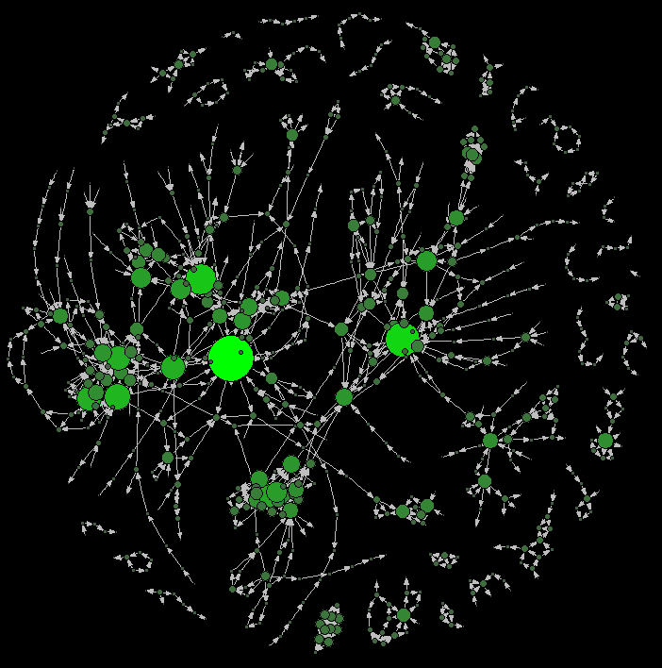
IGRAPH Object Attributes
Attributes of nodes and edges
Vertex Attributes – V(g)$...
V(g)$name – List of vertex names
V(g)$size – Vertex size
V(g)$color – Vertex color
V(g)$label – Vertex label (for plotting)
V(g)$value – Any value you want to store for a given node!
AOPWiki network with vertices colored and sized based on total degree for each node.
Notes:
Vertex size can be used to store results of different vertex-based analyses (like degree…)

Slide 31
IGRAPH Object Attributes
Attributes of nodes and edges
Vertex Attributes – V(g)$...
Edge Attributes – E(g)$...
V(g)$name – List of vertex names
V(g)$size – Vertex size
V(g)$color – Vertex color
V(g)$label – Vertex label (for plotting)
V(g)$value – Any value you want to store for a given node!
E(g)$name – List of edge names
E(g)$weight – Edge weight
E(g)$color – Edge color
E(g)$label – Edge label (for plotting)
E(g)$value – Any value you want to store for a given node!
Notes:
Edge weight is important for more than visualization

Slide 32
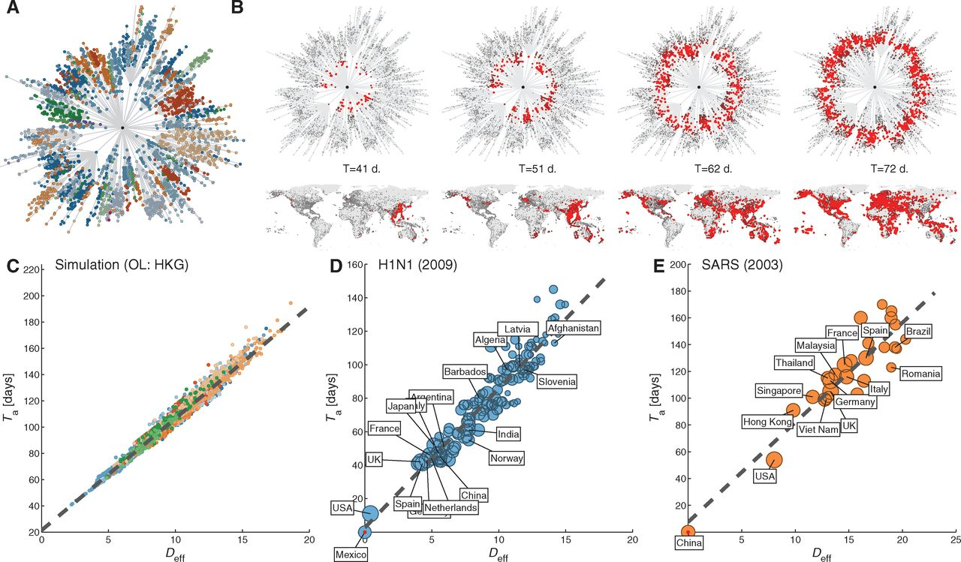
Attributes of nodes and edges
The Hidden Geometry of Complex, Network-Driven Contagion Phenomena; Brockmann & Helbing, Science 13 Dec 2013
Notes:
Edge weights might be spatial distances (below) or other weights. In this paper, the edge weights between locations in the spatial network are set to be based on flow through the airports. When they use this weighting, they find these amazing disease spread wavefronts!

Slide 33
Visualization of networks in R

Slide 34
Visualization of networks in R
Color, size, labels, and more
Graph layout options
Vertex and edges both have separate options in igraph. Common items to change include:
vertex.color
vertex.size
vertex.label
edge.color
edge.width
edge.label
edge.arrow.size
There are lots of built in options for layouts
layout_in_circle
layout_on_grid
layout.randomly
layout_as_tree
layout_as_star
and many more…
Lots of graph layouts included have specific names and applications
layout_with_gem
layout_with_sugiyama
layout_with_fr
and many more…
You can also specify your own layout
Topological sorting layout (presented later)
Notes:
Vertex and edge labels are called by default in R (they overwrite the vertex and edge name attributes)

Slide 35
Visualization of networks in R
Automatic Layout
R automatically chooses a layout to represent the network

Slide 36
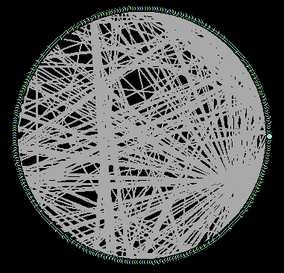
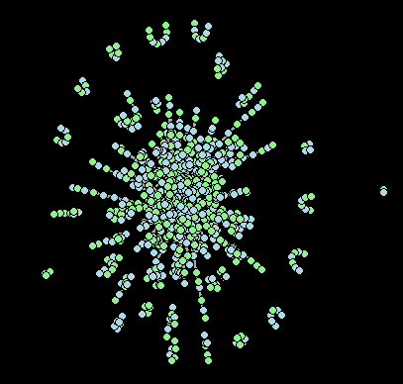
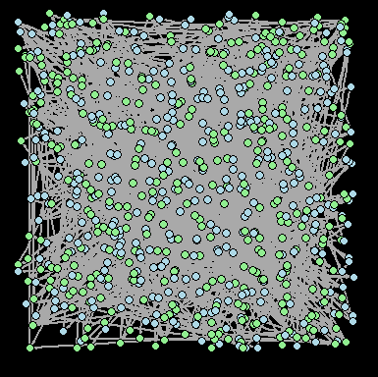
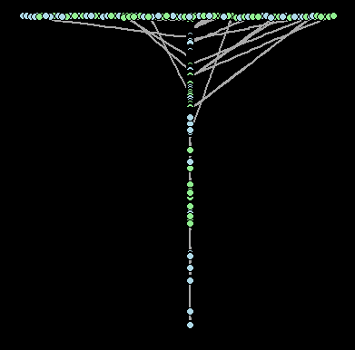
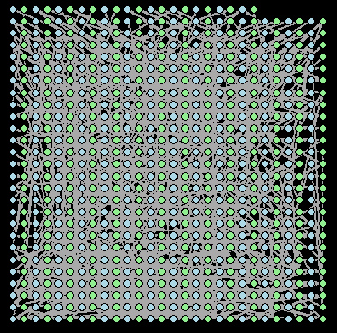
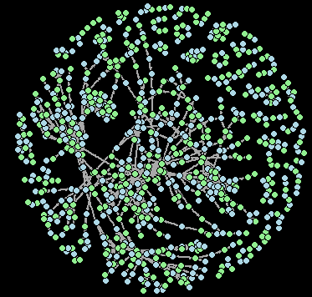
Visualization of networks in R
Circle
GEM
Random
Tree
Grid
“Nicely”

Slide 37
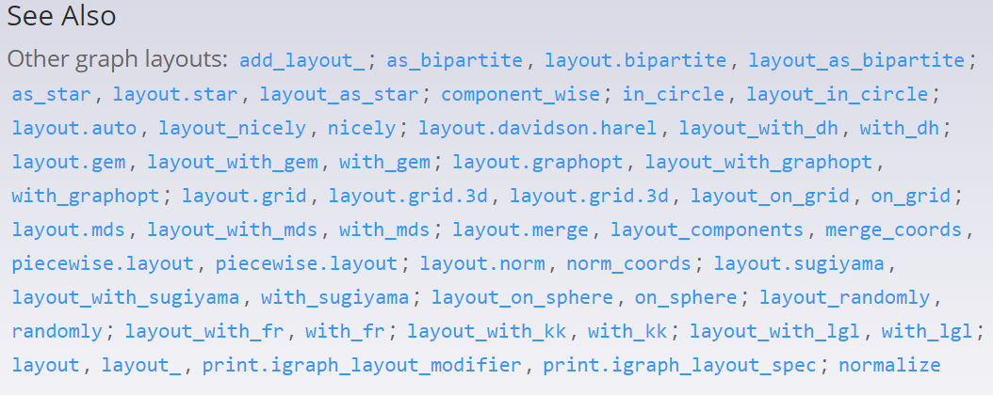
Visualization of networks in R
Circle
GEM
Random
Tree
Grid
“Nicely”

Slide 38
Visualization of networks in R
Circle
GEM
Random
My advice on choosing a layout is to read and experiment. Note: Almost all layouts have some random element so set.seed(#) is a good option for reproducing specific layouts.
Tree
Grid
“Nicely”

Slide 39
Visualization of networks in R
Circle
GEM
Random
Visualization is critical
Tree
Grid
“Nicely”

Slide 40
Visualization of networks in R
Circle
GEM
Random
Visualization is critical
Tree
Grid
“Nicely”

Slide 41
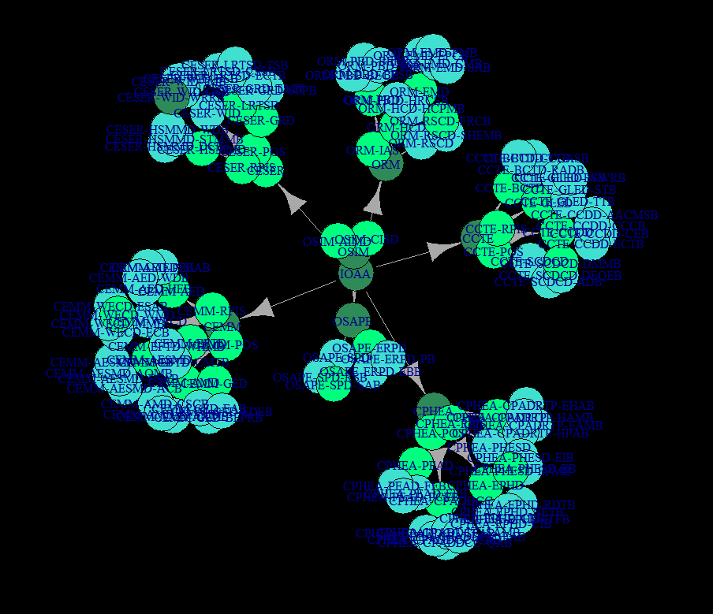

Slide 42
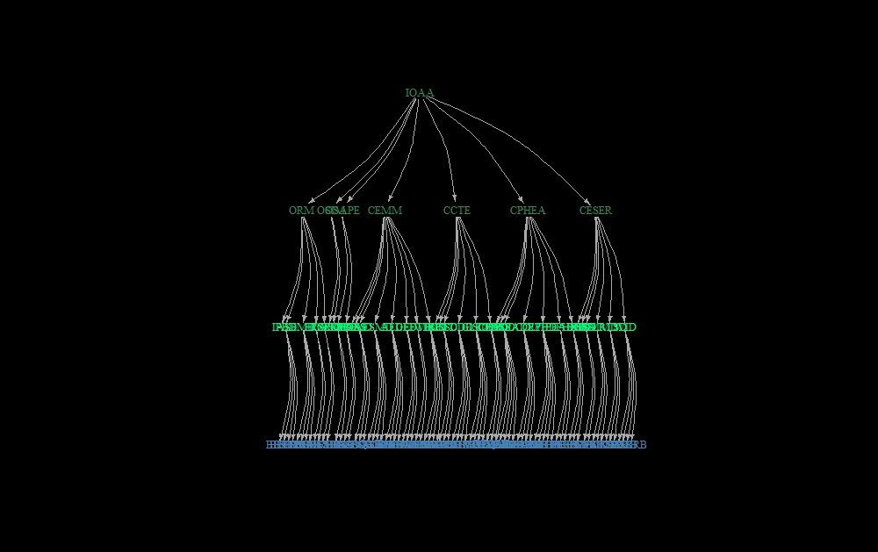

Slide 43
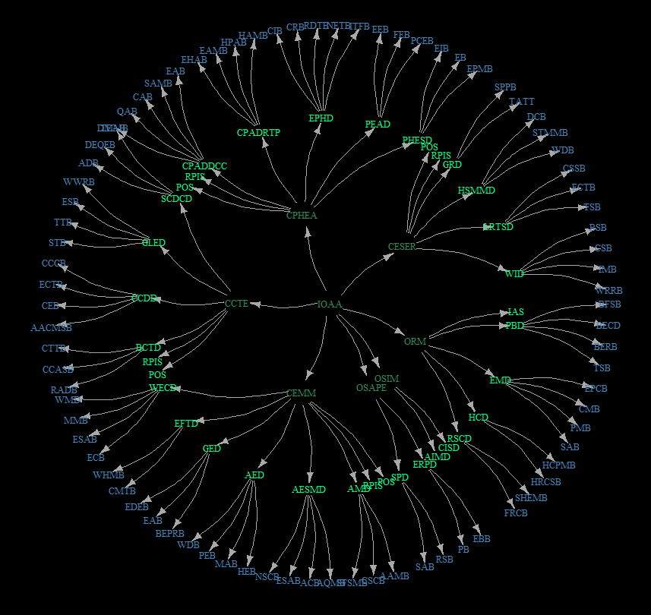

Slide 44
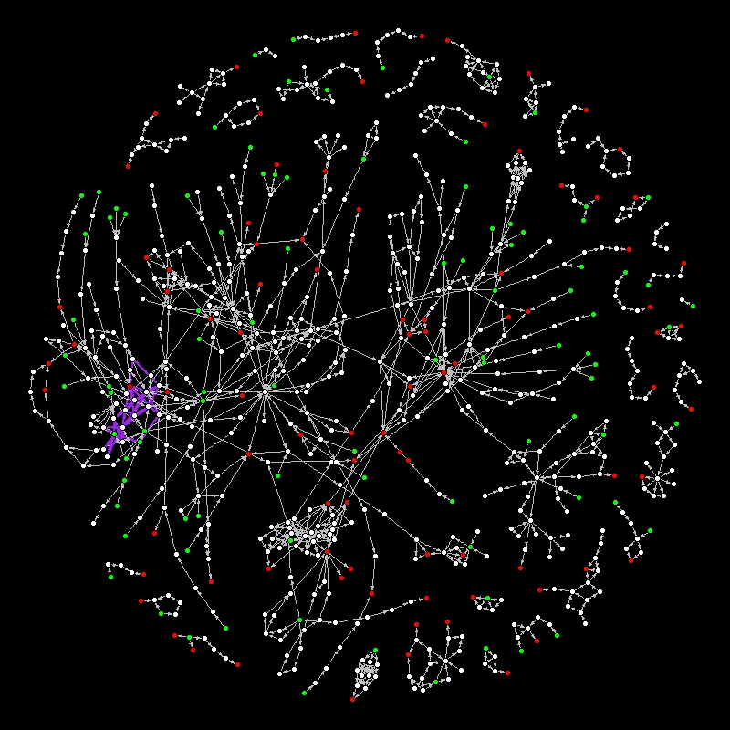
Notes:
For SETAC presentation, cut this down to just bulleted titles

Slide 45
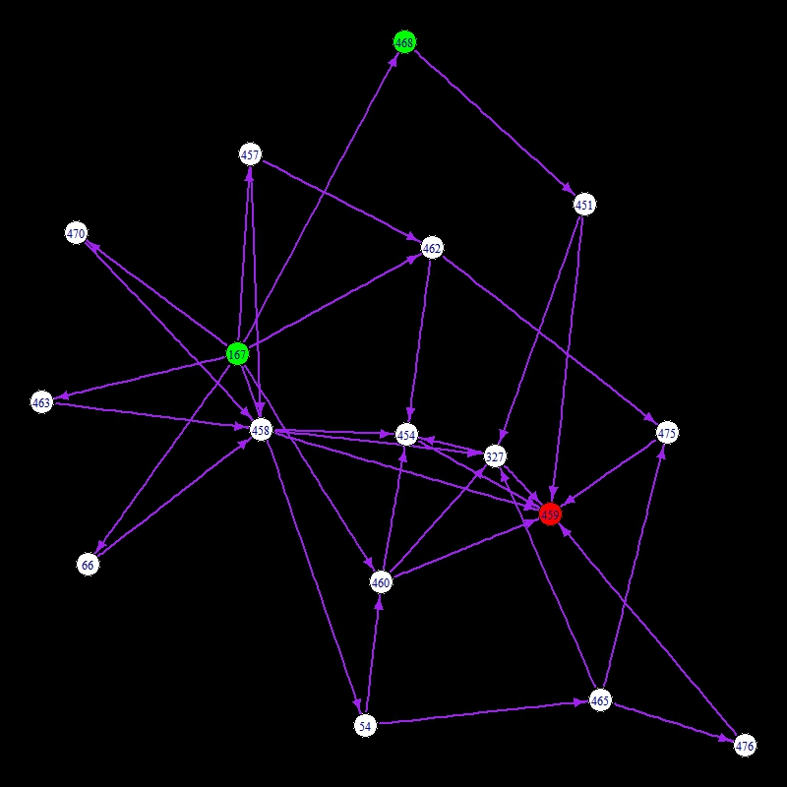
AOP Detection
The MIE and AO pair with the most simple paths is
MIE “Activation, LXR”
AO “Increased, Liver Steatosis”
with 35 unique simple paths from 16 KEs
These KEs are from 5 different user-specified AOPs

Slide 46
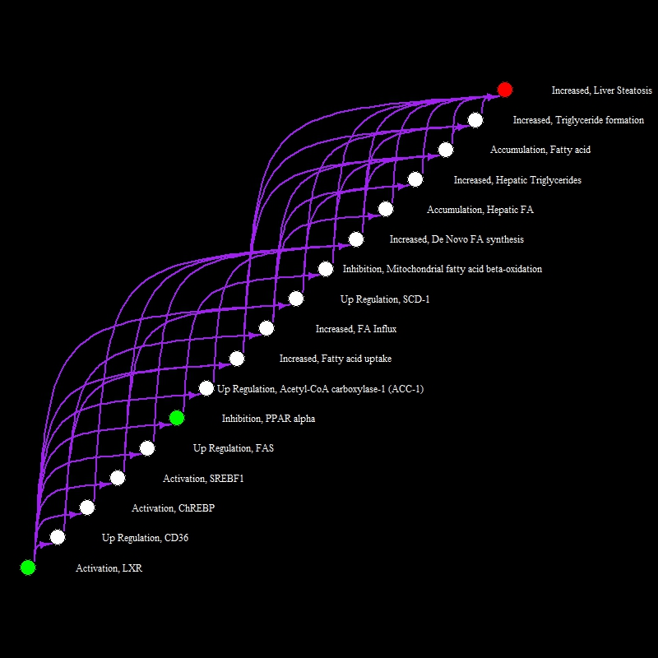
Visualization based on topological sorting
Notes:
This is a special network sorting, called a topological sort.

Slide 47
Sample network analyses

Slide 48
Sample network analyses
Network analytics and graph theory are two very large fields of research. There is also a world of models that utilize network structures. Today we will work with some of the standard analyses in R and also see some applications.

Slide 49
Sample network analyses
SOME TYPES OF NETWORK ANALYSES
Standard Analyses
Degree

Slide 50
Sample network analyses
SOME TYPES OF NETWORK ANALYSES
Standard Analyses
Degree
Total degree is 3
Degree in is 2
Degree out is 1

Slide 51
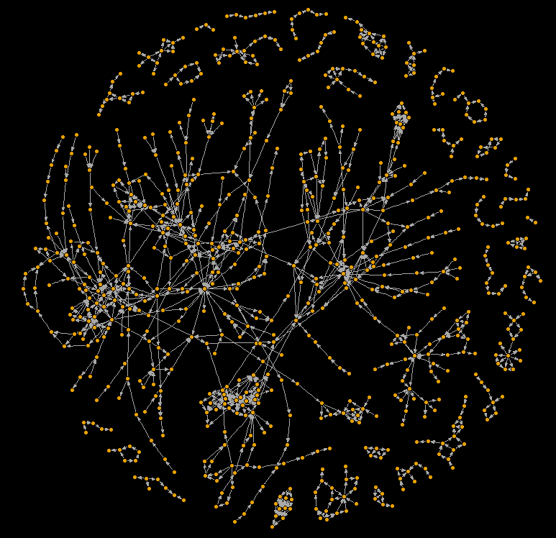
Sample network analyses
SOME TYPES OF NETWORK ANALYSES
Standard Analyses
Degree
Connected Components
Weakly or strongly connected
Path-based analyses
Shortest path between nodes
Betweenness
Closeness
Eccentricity

Slide 52
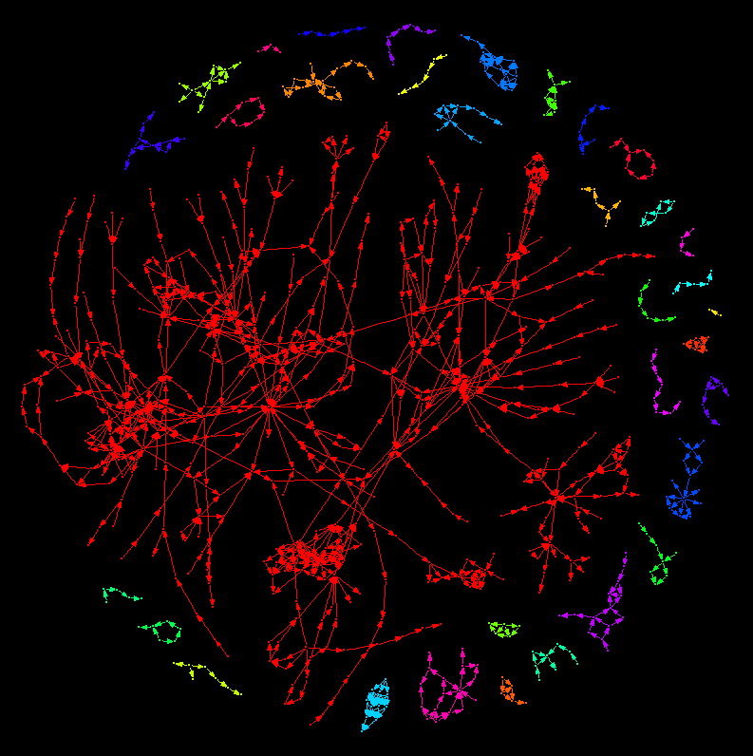
Sample network analyses
SOME TYPES OF NETWORK ANALYSES
Standard Analyses
Degree
Connected Components
Weakly or strongly connected
Path-based analyses
Shortest path between nodes
Betweenness
Closeness
Eccentricity

Slide 53
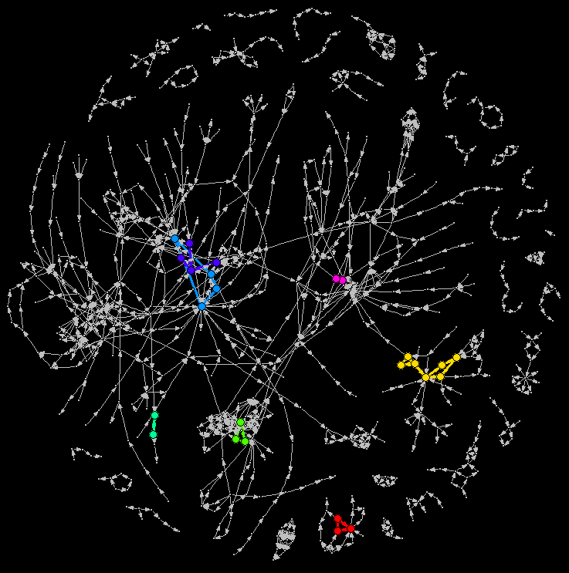
Sample network analyses
SOME TYPES OF NETWORK ANALYSES
Standard Analyses
Degree
Connected Components
Weakly or strongly connected
Path-based analyses
Shortest path between nodes
Betweenness
Closeness
Eccentricity

Slide 54
Sample network analyses
SOME TYPES OF NETWORK ANALYSES
Standard Analyses
Degree
Connected Components
Weakly or strongly connected
Path-based analyses
Shortest path between nodes
Betweenness
Closeness
Eccentricity
Graph distance
Total
Average
Maximum

Slide 55
Sample network analyses
SOME TYPES OF NETWORK ANALYSES
Standard Analyses
Degree
Connected Components
Weakly or strongly connected
Path-based analyses
Shortest path between nodes
Betweenness
Closeness
Eccentricity
Graph distance
Total
Average
Maximum “Diameter”

Slide 56
Sample network analyses
SOME TYPES OF NETWORK ANALYSES
Standard Analyses
Degree
Connected Components
Weakly or strongly connected
Path-based analyses
Shortest path between nodes
Betweenness
Closeness
Eccentricity
Graph distance
Total
Average
Diameter
Radius

Slide 57
Sample network analyses
SOME TYPES OF NETWORK ANALYSES
Standard Analyses
Degree
Connected Components
Weakly or strongly connected
Path-based analyses
Shortest path between nodes
Betweenness
Closeness
Eccentricity
Graph distance
Total
Average
Diameter
Radius
Ulna

Slide 58
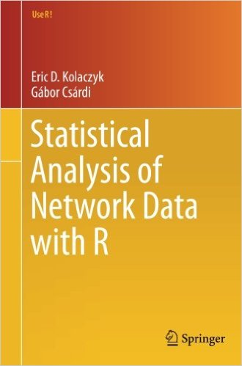
Statistical Analysis of Network Data with R (Kolaczyk and Csárdi, 2014)
Sample network analyses

Slide 59

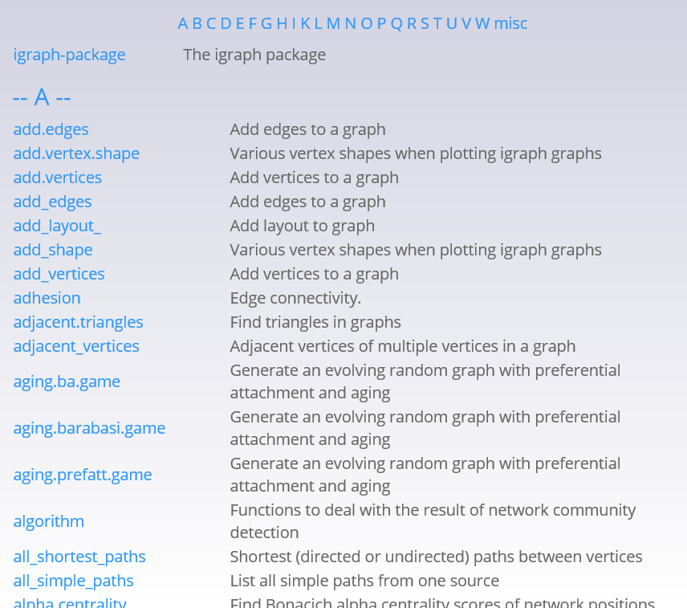
igraph has a nice website full of descriptions of igraph functions and code.
igraph.org

Slide 60
Ok, now it is time to make THIS Presentation like “q”

Slide 61

Ok, now it is time to make THIS Presentation like “q”
(and have it be followed by )

Slide 62
Take this time for a quick break.
~ Gather all materials and open up R Studio ~

Slide 63
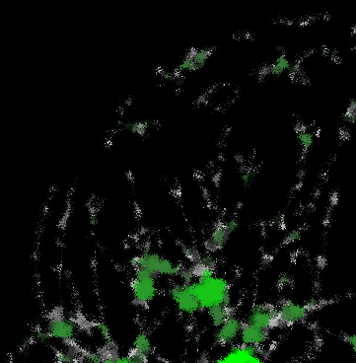
Degree Centrality Measures
Total degree
In-degree
Out-degree

Slide 64
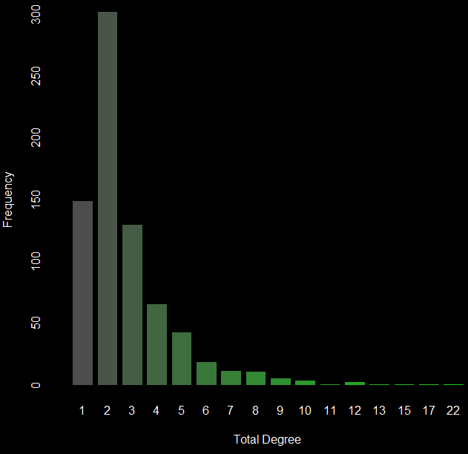
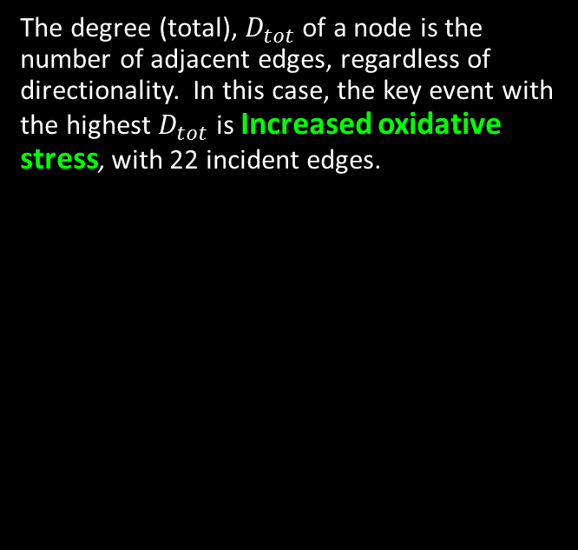
Degree (total) Heatmap
The degree (total), $D_{tot}$ of a node is the number of adjacent edges, regardless of directionality. In this case, the key event with the highest $D_{tot}$ is Increased oxidative stress, with 22 incident edges.
Notes:
To do: More specific information based on centrality measures. Expand to include better information about KEs, maybe show top ten?

Slide 65
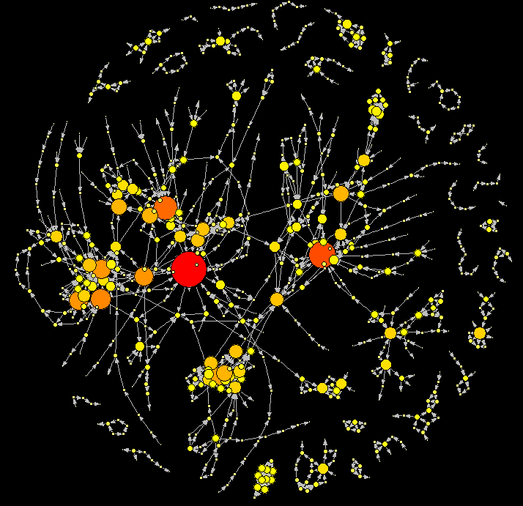
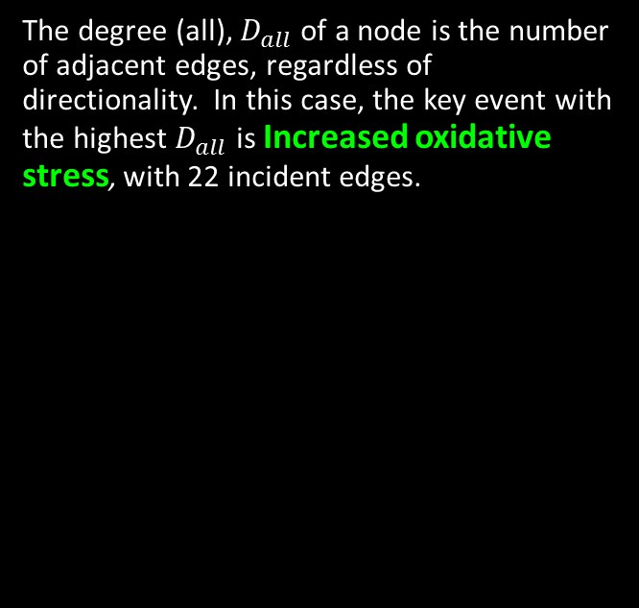



Degree (all) Heatmap
The degree (all), $D_{all}$ of a node is the number of adjacent edges, regardless of directionality. In this case, the key event with the highest $D_{all}$ is Increased oxidative stress, with 22 incident edges.
Ten key events with highest $D_{all}$ value
Key Event Name
"Increase, Oxidative Stress"
"Increased, Mortality"
"N/A, Mitochondrial dysfunction 1"
"Activation, PPAR$α$"
"Activation, LXR"
"Accumulation, Fatty acid"
"Activation, AHR"
"Increase, cilia movement"
"Increased, valve movement"
"Abnormal, Foraging activity and behavior"
$$D_{all}$$
22 17 15 13 12 12 12 11 10 10
Notes:
To do: More specific information based on centrality measures. Expand to include better information about KEs, maybe show top ten?

Slide 66
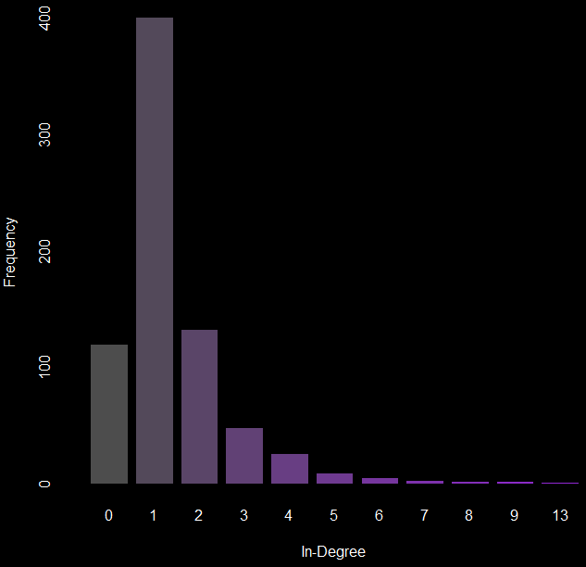
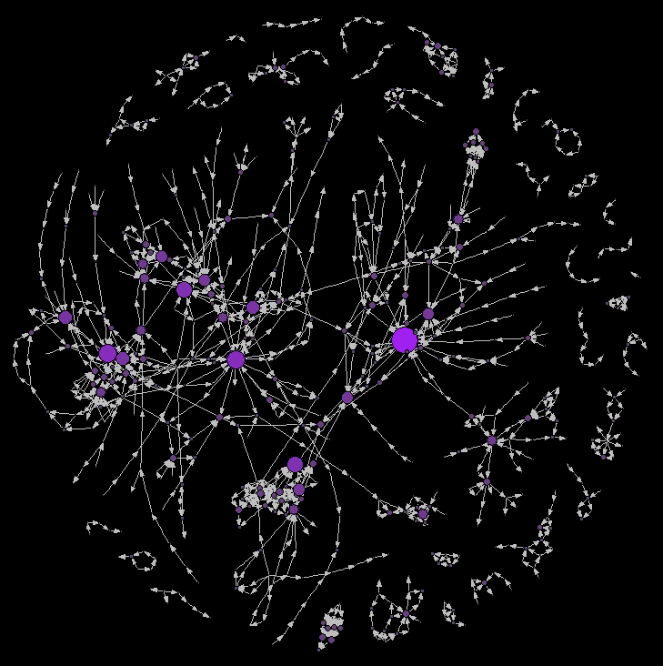
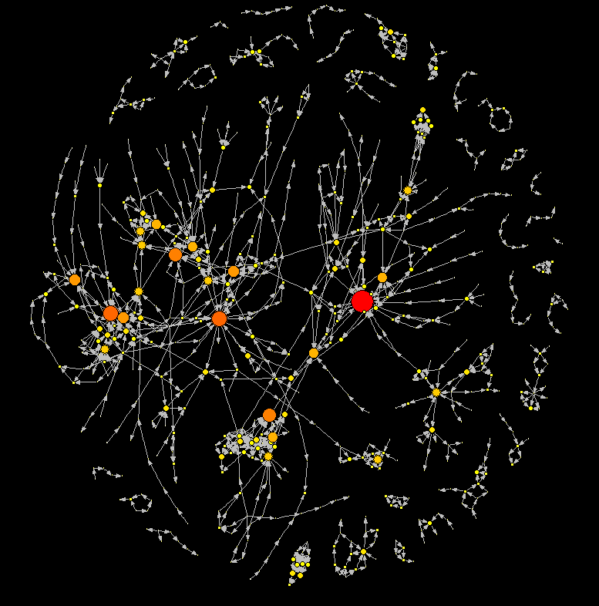
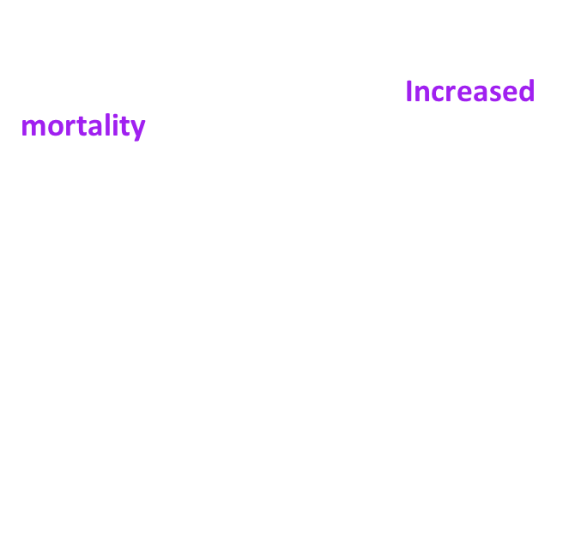
Degree (in) Heatmap
The degree (in), $D_{in}$ of a node is the number of adjacent edges coming into that node. The key event with the highest $D_{in}$ is Increased mortality, with 13 incident edges.
Notes:
To do: Incomplete AOP vs Complete AOP and ability to identify AOs and MIEs. With proper annotation we can use these analyses to identify complete vs incomplete AOPs.

Slide 67


Degree (in) Heatmap
The degree (in), $D_{in}$ of a node is the number of adjacent edges coming into that node. The key event with the highest $D_{in}$ is Increased mortality, with 13 incident edges.
Ten key events with highest $D_{in}$ value
Key Event Name
"Increased, Mortality"
"Increased, Liver Steatosis"
"Increase, Oxidative Stress"
"Decreased, Reproductive Success"
"Impairment, Learning and memory"
"Decreased, Synaptogenesis"
"Accumulation, Fatty acid"
"Reduction, 17beta-estradiol synthesis by ovarian granulosa cells"
"Depletion, energy reserves"
"Weakened, Colony"
$$D_{in}$$
13 9 9 8 8 7 7 7 6 6
Notes:
To do: Incomplete AOP vs Complete AOP and ability to identify AOs and MIEs. With proper annotation we can use these analyses to identify complete vs incomplete AOPs.

Slide 68
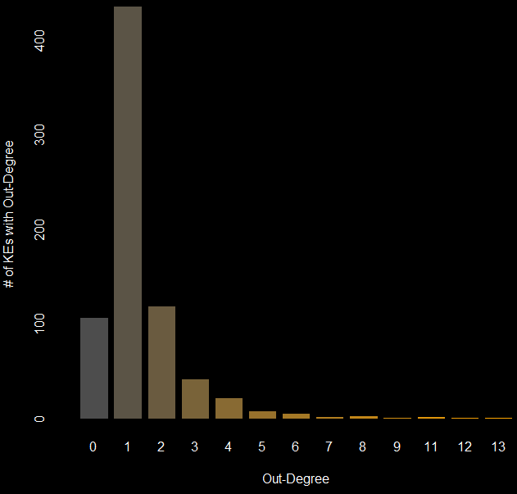
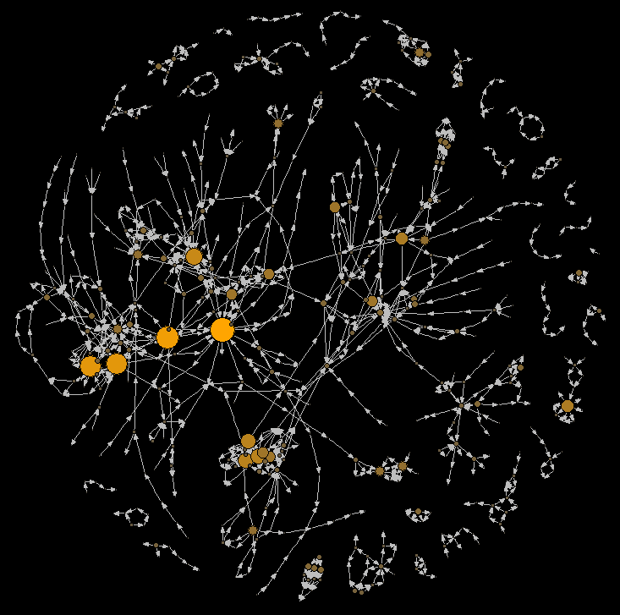
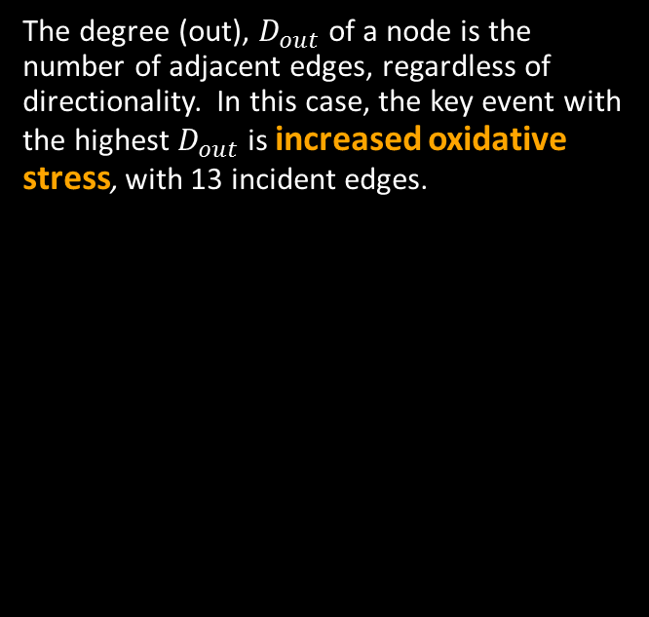
Degree (out) Heatmap
The degree (out), $D_{out}$ of a node is the number of adjacent edges, regardless of directionality. In this case, the key event with the highest $D_{out}$ is increased oxidative stress, with 13 incident edges.

Slide 69



Degree (out) Heatmap
The degree (out), $D_{out}$ of a node is the number of adjacent edges, regardless of directionality. In this case, the key event with the highest $D_{out}$ is increased oxidative stress, with 13 incident edges.
Ten key events with highest $D_{out}$ value
Key Event Name
"Increase, Oxidative Stress"
"Activation, AHR"
"Activation, PPAR$α$"
"Activation, LXR"
"N/A, Mitochondrial dysfunction 1"
"Increased, serotonin (5-HT)"
"Increase, cilia movement"
"Inhibition, 5-hydroxytryptamine transporter (5-HTT; SERT)"
"Suppression, Suppression of cytokine production in the presence of T-cell activation"
"Thyroxine (T4) in serum, Decreased"
$$D_{out}$$
13 12 11 11 9 8 8 8 7
7

Slide 70
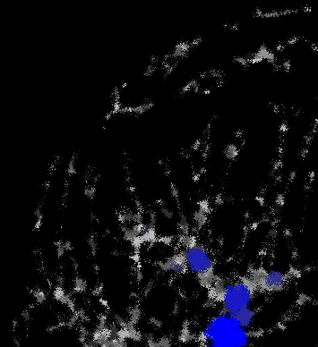
Distance- and path-based metrics
Betweenness
Directed
Undirected
Closeness
Total
In-Closeness
Out-Closeness
Eccentricity
Total Eccentricity
In-Eccentricity
Out-Eccentricity

Slide 71
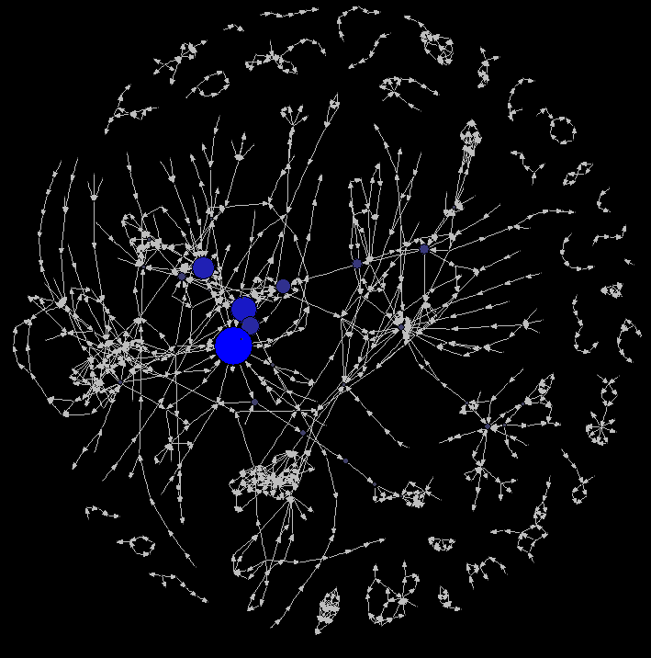
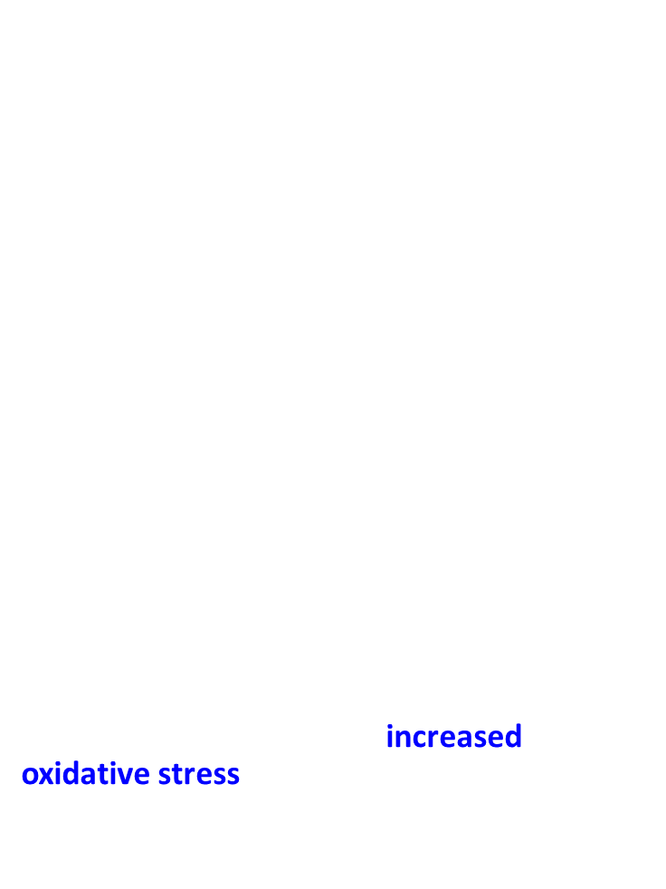
Betweenness Map
Betweenness values indicate which nodes are traversed most within shortest paths found in the network. A path is simply a set of edges (directed in this case) that connects nodes. Since multiple paths can exist between nodes, the betweenness calculation only uses those of which are the shortest (i.e. minimum number of steps between nodes).
The formula for betweenness is:
$$g\left(v\right)=\sum_{s≠v≠t}{\frac{σ_{st}\left(v\right)}{σ_{st}}}$$
Where $σ_{st}\left(v\right)$ is # of shortest paths from $s$ to $t$ through vertex $v$and$σ_{st}$ is # of shortest paths from $s$ to $t$ . Depending on the network, betweenness can be with respect to direction or not.
For the AOPwiki betweenness values range between 0 and 2360.167 and increased oxidative stress is the key event with the highest betweenness value when direction is considered.
Directed Betweenness

Slide 72
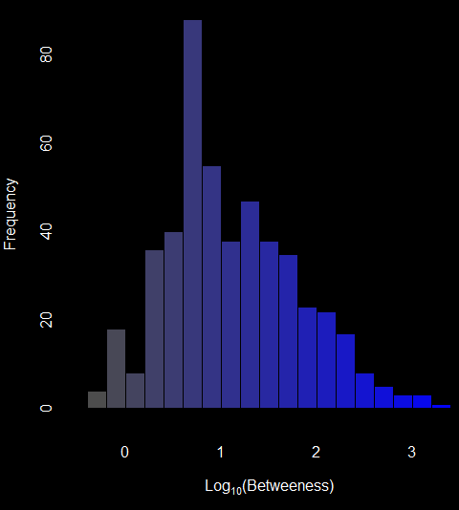
Betweenness Map
Betweenness values in the in the AOPwiki span 3 orders of magnitude from the largest to the smallest. The histogram below presents the frequency of log₁₀-transformed betweenness values.
Directed Betweenness

Slide 73




[1] "Increase, Oxidative Stress"
[2] "N/A, Cell injury/death"
[3] "N/A, Mitochondrial dysfunction 1"
[4] "Increased, Activation and Recruitment of Hepatic macrophages (Kupffer Cells)"
[5] "Reduced, Release of BDNF"
[6] "Thyroxine (T4) in serum, Decreased"
[7] "Thyroxine (T4) in neuronal tissue, Decreased"
[8] "Impairment, Learning and memory"
[9] "Increase, Cytotoxicity"
[10] "Increase, Tissue Degeneration, Necrosis & Atrophy"
Undirected Betweenness
Directed Betweenness
Undirected Betweenness
[1] "Increase, Oxidative Stress"
[2] "Increased, Mortality"
[3] "Altered, Cardiovascular development/function"
[4] "Increase, Mortality"
[5] "Increase, Pericardial edema"
[6] "N/A, Mitochondrial dysfunction 1"
[7] "Decrease, Population trajectory"
[8] "Decline, Population"
[9] "Activation, PPAR?"
[10] "Increased, blood potassium concentration"
Directed Betweenness

Slide 74
Betweenness in the AOP Context
Betweenness can be informative in identifying highly involved KEs in a global sense
When comparing directed to undirected betweenness we see a change in betweenness distribution among KEs. The KE with the highest betweenness value stays the same, but the top-ten values change quite a bit
Bi-modality in betweenness values also emerges when directionality is ignored
For AOPs and AOP networks we are perhaps more interested in looking at KEs that appear most frequently in paths between MIEs and AOs
In Villeneuve et al. 2017 (in prep.), we proposed MIE to AO path betweenness metric for more AOP specific network analysis

Slide 75

Closeness Map
Closeness is defined as the as the inverse of the average shortest path between a given node and all other nodes. This means that those nodes with the smallest average shortest path lengths, will have the largest closeness values.
When paths are found, we can consider all paths for the analysis, creating a total closeness value, or we can consider paths out of, or in to, nodes to calculate betweenness.
Total closeness

Slide 76

Closeness Map
Increased oxidative stress had the largest closeness value of all key events in the AOP wiki, however, all the key events in the large weakly connected component had very similar values.
Total closeness

Slide 77
Closeness Map
Increased oxidative stress had the largest closeness value of all key events in the AOP wiki, however, all the key events in the large weakly connected component had very similar values.
Total closeness

Slide 78



Total-closeness
In-closeness
Out-closeness
[1] "Increase, Oxidative Stress"
[2] "Increase, Pericardial edema"
[3] "Altered, Cardiovascular development/function"
[4] "Up Regulation, CYP1A1"
[5] "Altered regulation, AHR nuclear translocator (ARNT)-dependent pathways"
[6] "Increase, Mortality"
[7] "N/A, Mitochondrial dysfunction 1"
[8] "Activation, NADPH Oxidase"
[9] "Activation, AHR"
[10] "Decline, Population"
[1] "Suppression, Constitutive androstane receptor, NR1l3"
[2] "Activation, NRF2"
[3] "Activation, NR1H4"
[4] "Activation, AHR"
[5] "Activation, PPAR?"
[6] "Thyroperoxidase, Inhibition"
[7] "Inhibition, Na+/I- symporter (NIS)"
[8] "Inhibition, Iodotyrosine deiodinase (IYD)"
[9] "Decreased, Thyroidal iodide uptake"
[10] "Inhibition, Dual oxidase"
[1] "Alterations, Food-web structures"
[2] "Increased, Alterations of food-web structures"
[3] "Alteration, Food-web structures"
[4] "Decline, Population"
[5] "Reproductive failure"
[6] "Death/Failure, Colony"
[7] "Weakened, Colony"
[8] "impaired, Hive thermoregulation"
[9] "Decrease, Number of worker bees"
[10] "impaired, Larval development"

Slide 79


Total-closeness
In-closeness
Out-closeness
[1] "Increase, Oxidative Stress"
[2] "Increase, Pericardial edema"
[3] "Altered, Cardiovascular development/function"
[4] "Up Regulation, CYP1A1"
[5] "Altered regulation, AHR nuclear translocator (ARNT)-dependent pathways"
[6] "Increase, Mortality"
[7] "N/A, Mitochondrial dysfunction 1"
[8] "Activation, NADPH Oxidase"
[9] "Activation, AHR"
[10] "Decline, Population"
[1] "Suppression, Constitutive androstane receptor, NR1l3"
[2] "Activation, NRF2"
[3] "Activation, NR1H4"
[4] "Activation, AHR"
[5] "Activation, PPAR?"
[6] "Thyroperoxidase, Inhibition"
[7] "Inhibition, Na+/I- symporter (NIS)"
[8] "Inhibition, Iodotyrosine deiodinase (IYD)"
[9] "Decreased, Thyroidal iodide uptake"
[10] "Inhibition, Dual oxidase"
[1] "Alterations, Food-web structures"
[2] "Increased, Alterations of food-web structures"
[3] "Alteration, Food-web structures"
[4] "Decline, Population"
[5] "Reproductive failure"
[6] "Death/Failure, Colony"
[7] "Weakened, Colony"
[8] "impaired, Hive thermoregulation"
[9] "Decrease, Number of worker bees"
[10] "impaired, Larval development"

Slide 80
Closeness in the AOP context
Total closeness
When paths are considered without direction, closeness does not seem to distinguish well between KEs, other than to point out the relevance of knowing the Component structure of the network
When in- and out-closeness are considered, we see that the effect of the component structure is still present, but not as dramatically
In-closeness determines those KEs with the average shortest paths upstream
Out-closeness determines those KEs with the average shortest paths downstream
These analyses may gain relevance by considering MIE to AO paths
In-closeness
Out-closeness

Slide 81

Eccentricity Map
Eccentricity is defined to be maximum of the shortest path lengths between a given node and all other nodes in the network.
Eccentricity values indicate which nodes may the most difficult to reach within a network.
In a disconnected network, if no paths between nodes exist, this would lead to infinite eccentricity values, however, if eccentricity is calculated within components, infinite values can be avoided.

Slide 82


Eccentricity Map
Eccentricity values are again bi-modal, based on inclusion in the largest connected component. In an undirected sense, the most eccentric KEs in the AOPwiki are Activation Glucocorticoid Receptor, Reproductive Failure, and Inhibition 4-hydroxyphenyl-pyruvate dioxygenase (HPPD) enzyme

Slide 83



In-Eccentricity
[1] "Tumorigenesis, Hepatocellular carcinoma"
[2] "Clonal Expansion/Cell Proliferation, to form Altered Hepatic Foci (AHF)"
[3] "Increased, Clonal Expansion / Cell Proliferatin to form Pre-Neoplastic Altered Hepatic Foci"
[4] "Increased, Proliferation/Clonal Expansion of Mutant Cells (Pre-Neoplastic Lesions/Altered H"
[5] "Reproductive failure"
[6] "N/A, Hypertension"
[7] "Increase, Site of Contact Nasal Tumors"
[8] "Increase, Mutations in Critical Genes"
[9] "Increased, Induced Mutations in Critical Genes"
[10] "Defect of Embryogenesis"
Total Eccentricity
Out-Eccentricity
[1] "N/A, Reproductive failure"
[2] "Inhibition, 4-hydroxyphenyl-pyruvate dioxygenase (HPPD) enzyme"
[3] "Activation, Glucocorticoid Receptor"
[4] "Increased, Plasma tyrosine"
[5] "Induction, IKB inhibitory protein"
[6] "Reduction, Eggshell thickness"
[7] "N/A, Breast Cancer"
[8] "Increased, Second Messenger Production"
[9] "Increased, Migration (Endothelial Cells)"
[10] "Increase, Cell Proliferation (Epithelial Cells)"
[1] "Inhibition, Dual oxidase"
[2] "Inhibition, Pendrin"
[3] "Inhibition, Iodotyrosine deiodinase (IYD)"
[4] "Inhibition, Na+/I- symporter (NIS)"
[5] "Inhibition, Ca++ ATPase"
[6] "Binding of agonist, Ionotropic glutamate receptors"
[7] "Decreased, Thyroidal iodide uptake"
[8] "Binding of agonist, NMDARs"
[9] "Thyroperoxidase, Inhibition"
[10] "Thyroid hormone synthesis, Decreased"

Slide 84
Total Eccentricity
Eccentricity in the AOP context
In contrast to closeness, eccentricity will provide an idea of which KEs are the most remotely connected.
When In-Eccentricity is calculated, the KEs that stand-out will be those usually at the beginning of a long linear AOP progression. These are likely to be MIEs where multiple KEs must be traversed to get into the larger network.
When Out-Eccentricity is calculated, the KEs that stand-out will be those at the end of long linear AOP progressions. These are likely AOs with specific sequences of KEs required to activate them.
In-Eccentricity
Out-Eccentricity

